Slide 1

Simply online
Simple way to connect

Slide 2
agenda
Team Member Roles & Responsiblities​
Improvements made from Professor Feedback​
Project Description​
Team Working Agreement​
Personas​
Minimal Viable Product (MVP)​
Technologies​
Algorithms​
Diagrams​
Sprint 1-6 Recap​
Product Backlog​
Stories and Acceptance Criteria​
Metrics​
Retrospective​
Sprint 7​
Project Demo – Sprint 7
Github link​
Live Application Demo
Test cases
Completed and Not Completed Tasks
Sprint7 Backlog​

Slide 3
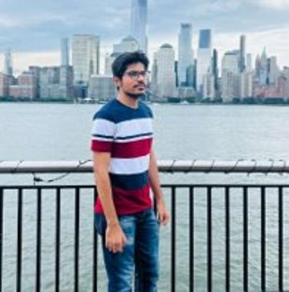
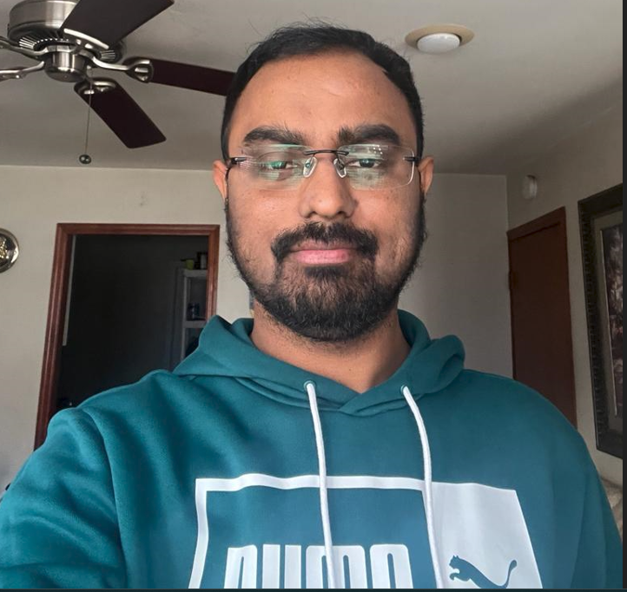
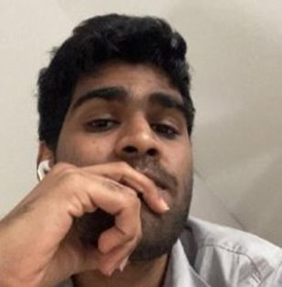
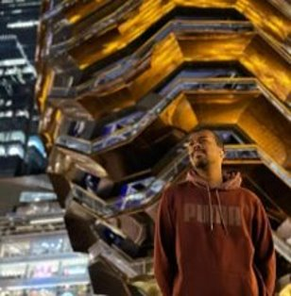
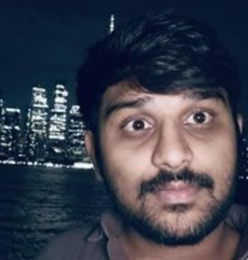
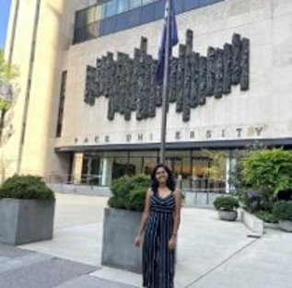
Team Members
Amarendra Reddy
Developer
Pruthvi Raj Reddy
DBA
Mounik
Developer
Ajay kumar
Full Stack Developer
Raviteja Reddy
Developer
Sreeja Reddy
Quality Analyst

Slide 4
Team Working Agreement
Participation:​
All the team members are expected to involve in project discussions and attend the meetings promptly. Absence during multiple meetings will affect the team’s performance and efficiency. ​
The team member can discuss beforehand with the team leader if he/she is going to miss the meeting or make it up for it before the next meeting is scheduled.
​
Communication:​
The team will communicate with each other using WhatsApp group and meetings will be scheduled on Zoom.​
Jira software will be used to track the assigned tasks. For any dependency on another task, mention it in the task comments.​
Task management, bugs, sprint planning, and meeting minutes will be tracked in Jira.​
To share the final deliverables, Google docs will be used where all the team members can edit the document.
Work Division:​
The entire project work should be divided into equal parts, and equal responsibilities should be given to all the team members.​
Each team member should complete their division of work before the deadline. If they are unable to complete the work on time, that hinders the performance of the entire team. If in case a team member is facing trouble and issues at some point, they can share it with others so that they can help each other and complete the work before the deadline.​
​
Meetings:​
All the team members will meet on zoom virtually every Tuesday and Friday. All the team members must be present, as attendance is mandatory unless there is an exceptional case.​
The team leader would be responsible for sending meeting details and conducting the meeting.​
A meeting track or meeting minutes report would be listed after every meeting to keep track of the project and its progress.​
Every team member is expected to come up with ideas, participate in the discussion, and give an update on their progress for their part of the work.
TEAM MEMBERS​
AJAY KUMAR​
AMARENDRA REDDY​
RAVI TEJA​
SREEJA​
PRUTHVI RAJ​
MOUNIK

Slide 5
Project Description
Project Name: | Simply Online
Team Name: | New York Knicks
Project Description | Simply Online is a web application that aims to simplify the process of online classes or meetings. This application allows users to create virtual rooms and share room IDs and enables automatic attendance marking to eliminate the need for manual tracking. For users who want to conduct the meetings and mark the presence of the users in the meetings using face recognition, the Simply Online app is a user-friendly platform that offers to create virtual rooms and easily verify the users in the meetings. Unlike traditional methods of verifying people without face recognition. our solution provides easy access to conduct meetings and mark attendance using face recognition.
Benefit Outcomes: | This application offers a comprehensive and user-friendly solution for educators and students to enhance their online learning experience Convenient for presenters to recognize the people. With our focus on delivering measurable benefits to our users, we believe that Simply Online has the potential to transform virtual meeting users.
GitHub Wiki: | Github wiki page

Slide 6

Improvement from the Professor’s feedback
We incorporated the professor’s feedback and made improvements to the presentation. ​
Metrics​
Product backlog and acceptance criteria
Test Cases

Slide 7
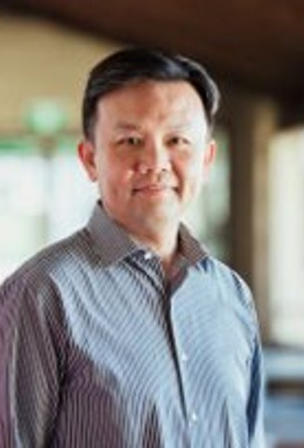
Persona
Name: Professor James​​
Age: 45​​
Occupation: University Professor​​
Profile:​
James is a tenured professor in the Computer Science department at a large university.
He teaches both undergraduate and graduate-level courses and conducts research in his field.
Due to the COVID-19 pandemic, his classes have been moved online, and he uses various platforms to deliver lectures, holds office hours, and communicate with his students.
He lives with his spouse and two children, who are also attending school virtually.
Goals and Motivations:​
Deliver high-quality lectures and course material to his students​ Engage his students and create a dynamic and interactive virtual classroom environment.​
Ensure that his students are keeping up with the coursework and meeting their learning objectives.​
Provide effective feedback and support to his students.

Slide 8

Persona
Name: Sarah​
Age: 24​
Occupation: College student
Profile:​
Sarah is a full-time student pursuing a degree in psychology. Due to the COVID-19 pandemic, her classes have been moved online, and she uses Zoom to attend lectures, participate in group discussions, and communicate with her professors and classmates. ​
She lives in a small apartment with roommates and shares a room with one of them. ​
She has a busy schedule and often has to balance her coursework with a part-time job and other responsibilities.
Goals and Motivations:​
Attend all her classes and be an active participant in class discussions​ Stay organized and manage her time effectively to meet assignment deadlines.​
Have a reliable and user-friendly platform for attending virtual classes. Connect with her professors and classmates, and build a community within her course

Slide 9

Persona
Name: Ishika​
Age: 27​
Occupation: Elementary school teacher
Profile: ​
Ishika is a dedicated elementary school teacher who loves working with children. She has been teaching for three years and is always looking for ways to improve her classroom management and student engagement.
Ishika is originally from India but moved to the US with her family when she was a child. She is fluent in English and Hindi and enjoys cooking traditional Indian dishes in her free time
Goals and Motivations:​
Ishika is a dedicated elementary school teacher who loves working with children. She has been teaching for three years and is always looking for ways to improve her classroom management and student engagement. Ishika is originally from India but moved to the US with her family when she was a child. She is fluent in English and Hindi and enjoys cooking traditional Indian dishes in her free time​
Ishika’s main goal is to create a safe and engaging learning environment for her students. She wants to be able to take attendance quickly and efficiently so she can spend more time teaching and less time on administrative tasks. Sarah is also motivated by the opportunity to track student attendance and identify patterns that might indicate a need for additional support.

Slide 10

MINIMAL VIABLE PRODUCT

Slide 11
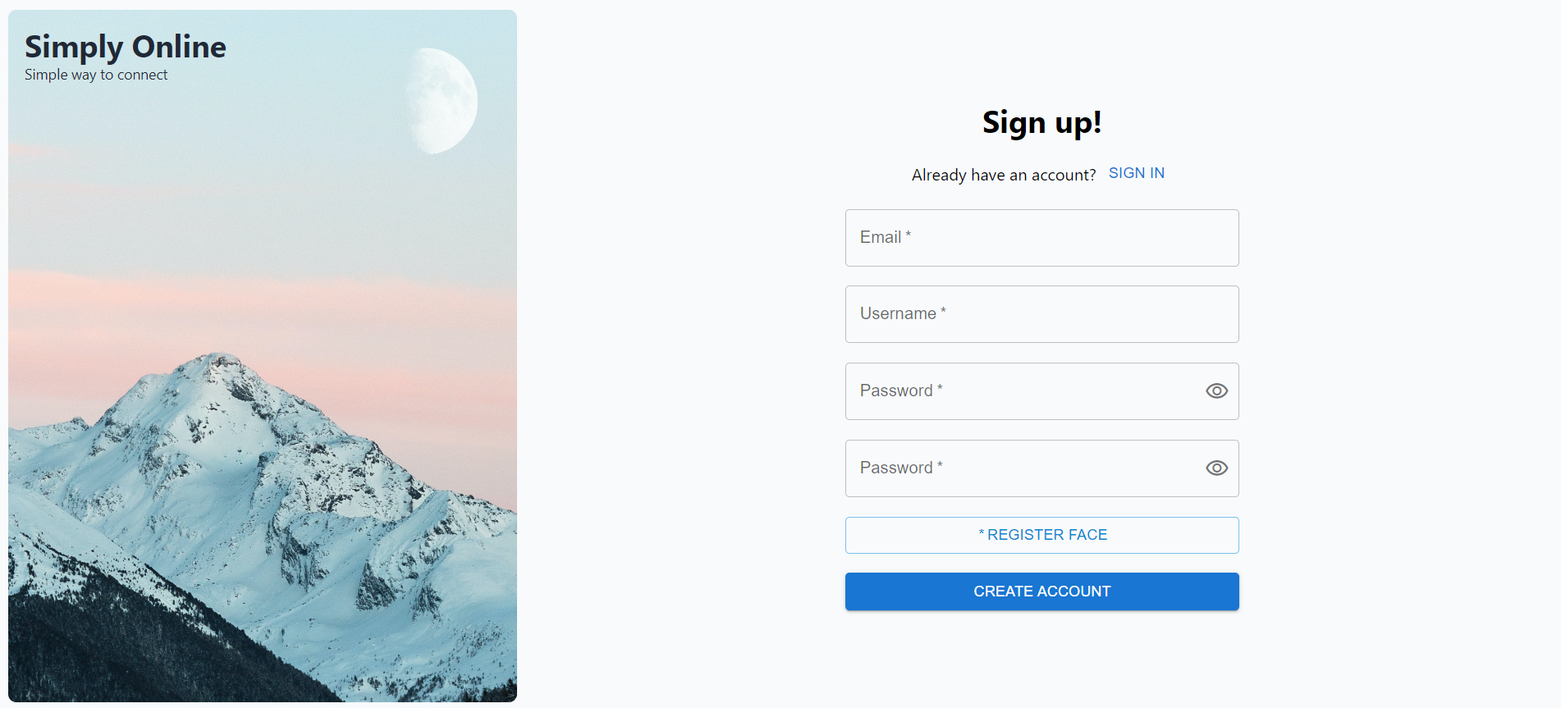
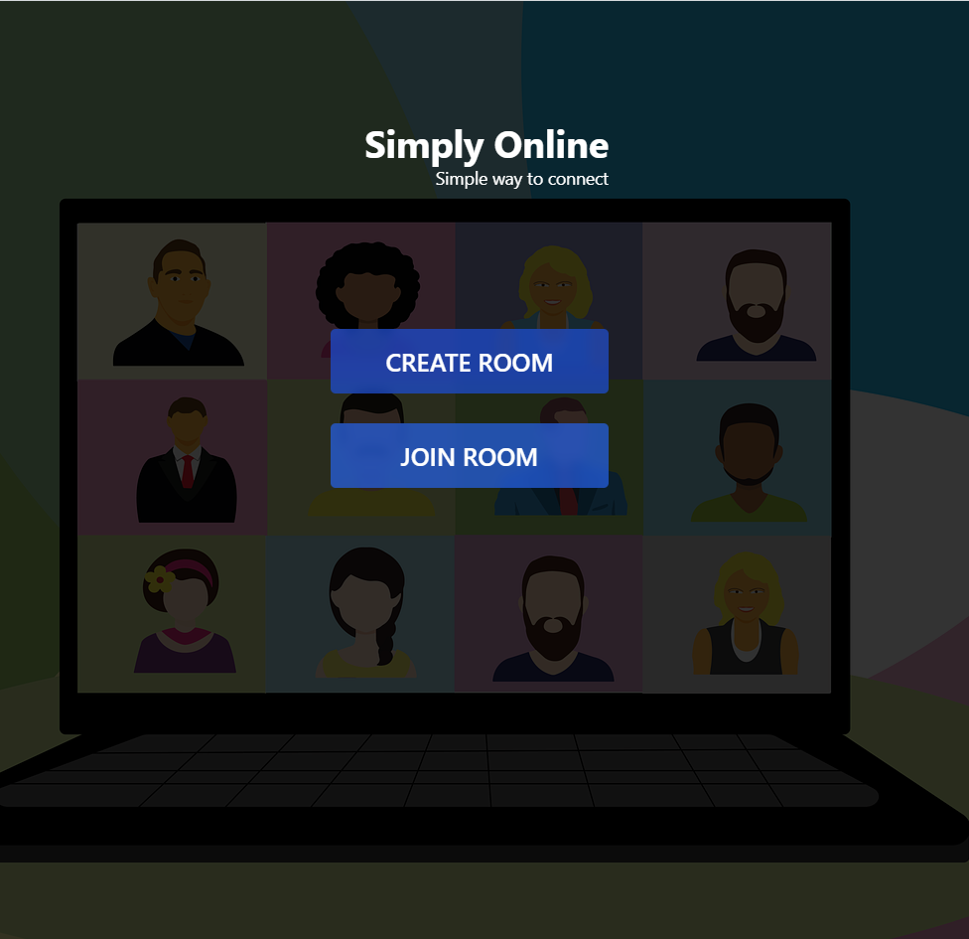
Home page

Slide 12
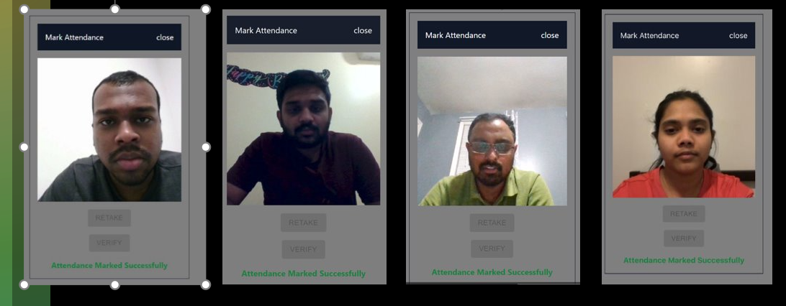
Individual Mark Attendance

Slide 13
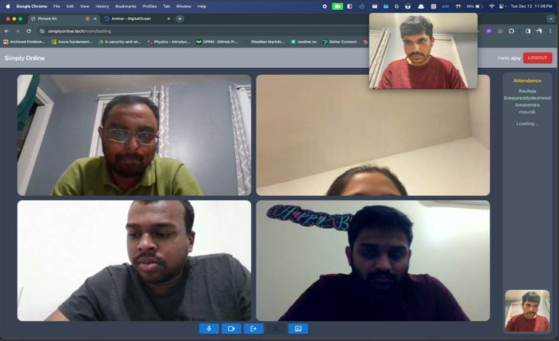
User Attendance Board

Slide 14
















Technologies

Slide 15
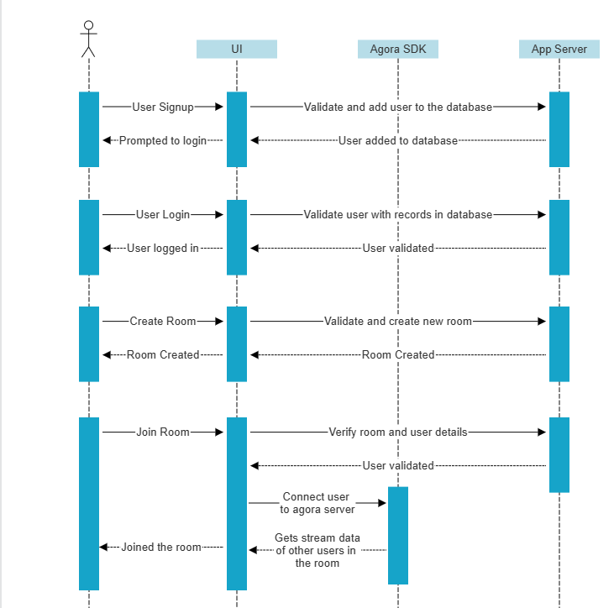
Sequence Diagram

Slide 16
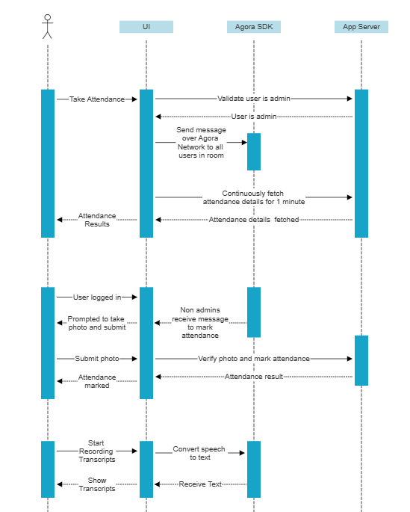
Sequence Diagram

Slide 17
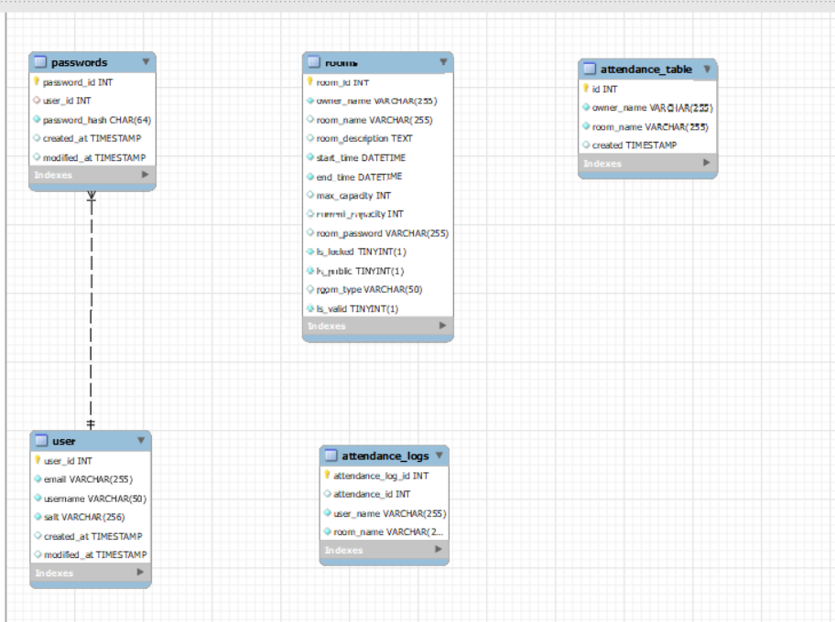
ER Diagram

Slide 18

Sprint 1-6
Recap

Slide 19
Sprint-1
STORY ID | USER STORY | STORY POINTS
SIM-6 | Discussion on Framework selection | 5
SIM-7 | Create React Project | 13
SIM-8 | Research on WebRTC | 8
SIM-9 | Research on Face Recognition Implementation | 13
In this sprint, we did research on Frameworks, WebRTC and Face Recognition Implementation.

Slide 20
Sprint-2
STORY ID | USER STORY | STORY POINTS
SIM-10 | Create Web app and connect to signalling server to generate Ice Candidates | 8
SIM-11 | Create Connection between two peers and enable video and audio calling | 20
SIM-12 | Create UX and UI for users to create and join rooms | 8
SIM-13 | Research on SFU server for group calling feature | 8
SIM-24 | Database analysis and Development | 5
SIM-26 | Connect business layer and Database layer (MYSQL DATABASE) | 5
In Sprint 2, we created connection between two peers and enabled video calling and created UX and UI for users to create and join rooms

Slide 21
Minimal Viable Product (MVP)
The following are the features that we are covering in our MVP:
Homepage
JOIN ROOM
CREATE ROOM
Peer to Peer connection

Slide 22
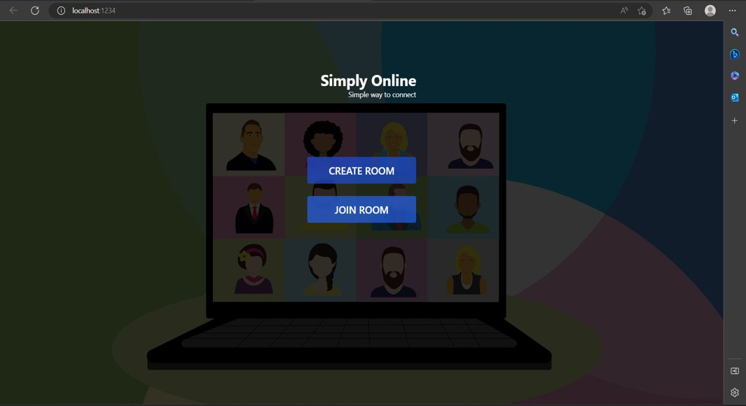
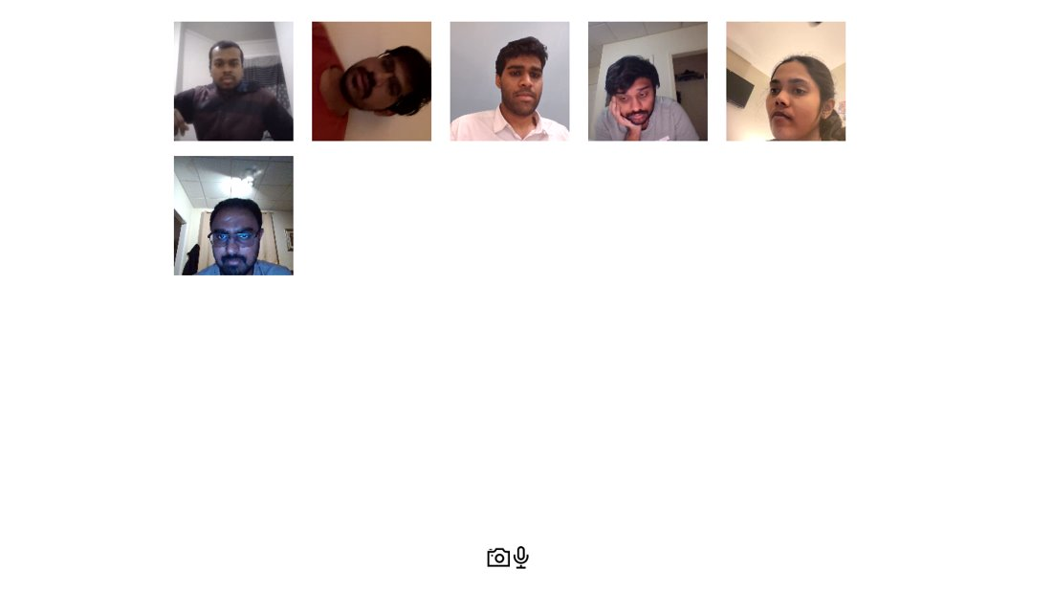
Minimal Viable Product (MVP)

Slide 23
Sprint 3
STORY ID | USER STORY | STORY POINTS
SIM-14 | Create UX & UI screen for group calling | 8
SIM-15 | Test the maximum users that can be connected to one group call using peer to peer | 5
SIM-16 | Create Face recognition model using tensor flow | 40
SIM-18 | Analysis and implementation of facial recognition model using tensor flow | 5
SIM-25 | Connect to Agora RTC Server to enable group video calling | 20
SIM-31 | UX changes for better interactivity | 4
SIM-32 | Implement video conference UI using agora react component library | 16
SIM-33 | Face recognition implementation using Deepface | 40
SIM-34 | Research on Deepface | 4
SIM-35 | Create a web API’s using flask to connect to face recognition code | 8
SIM-36 | Implement face recognition in UI | 14
In this Sprint, we worked on join room/ create room and UX changes for better interactivity

Slide 24
Home Page
Home page has a simple interface where users can create new rooms or join existing rooms.

Slide 25
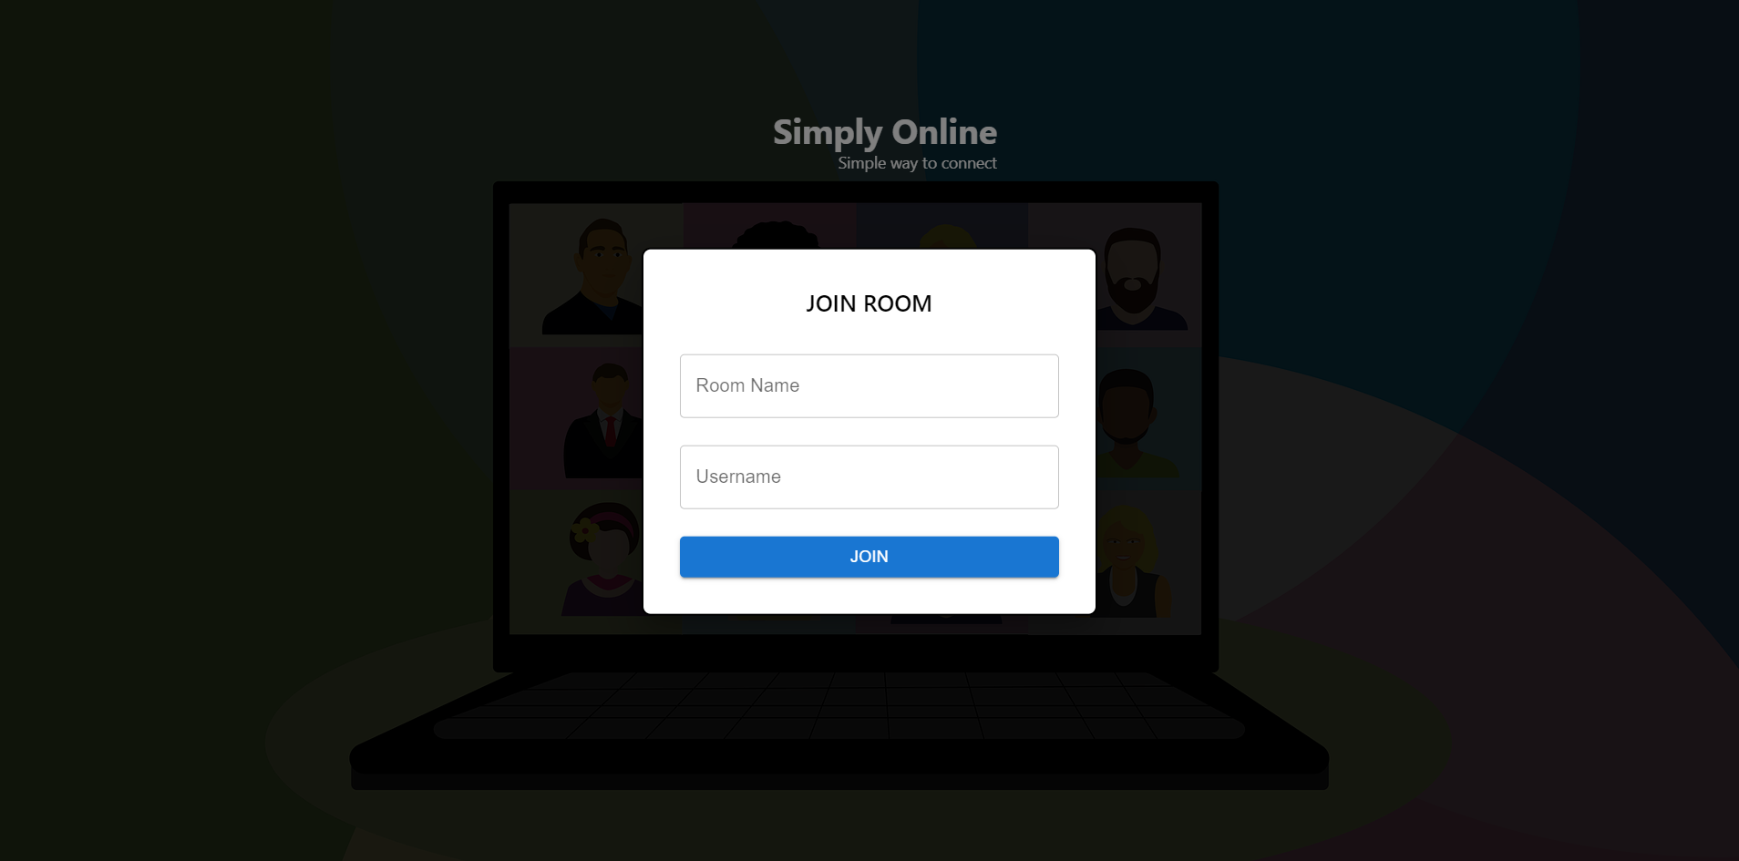
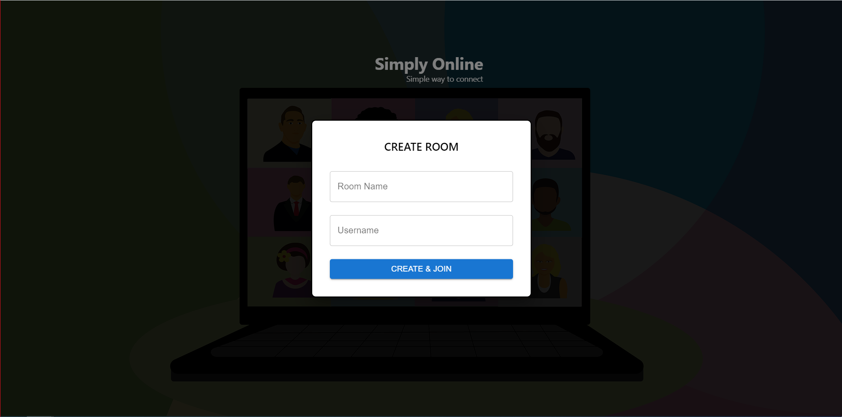
Create/Join Room
User can create or Join a room by providing Room Name and Username

Slide 26
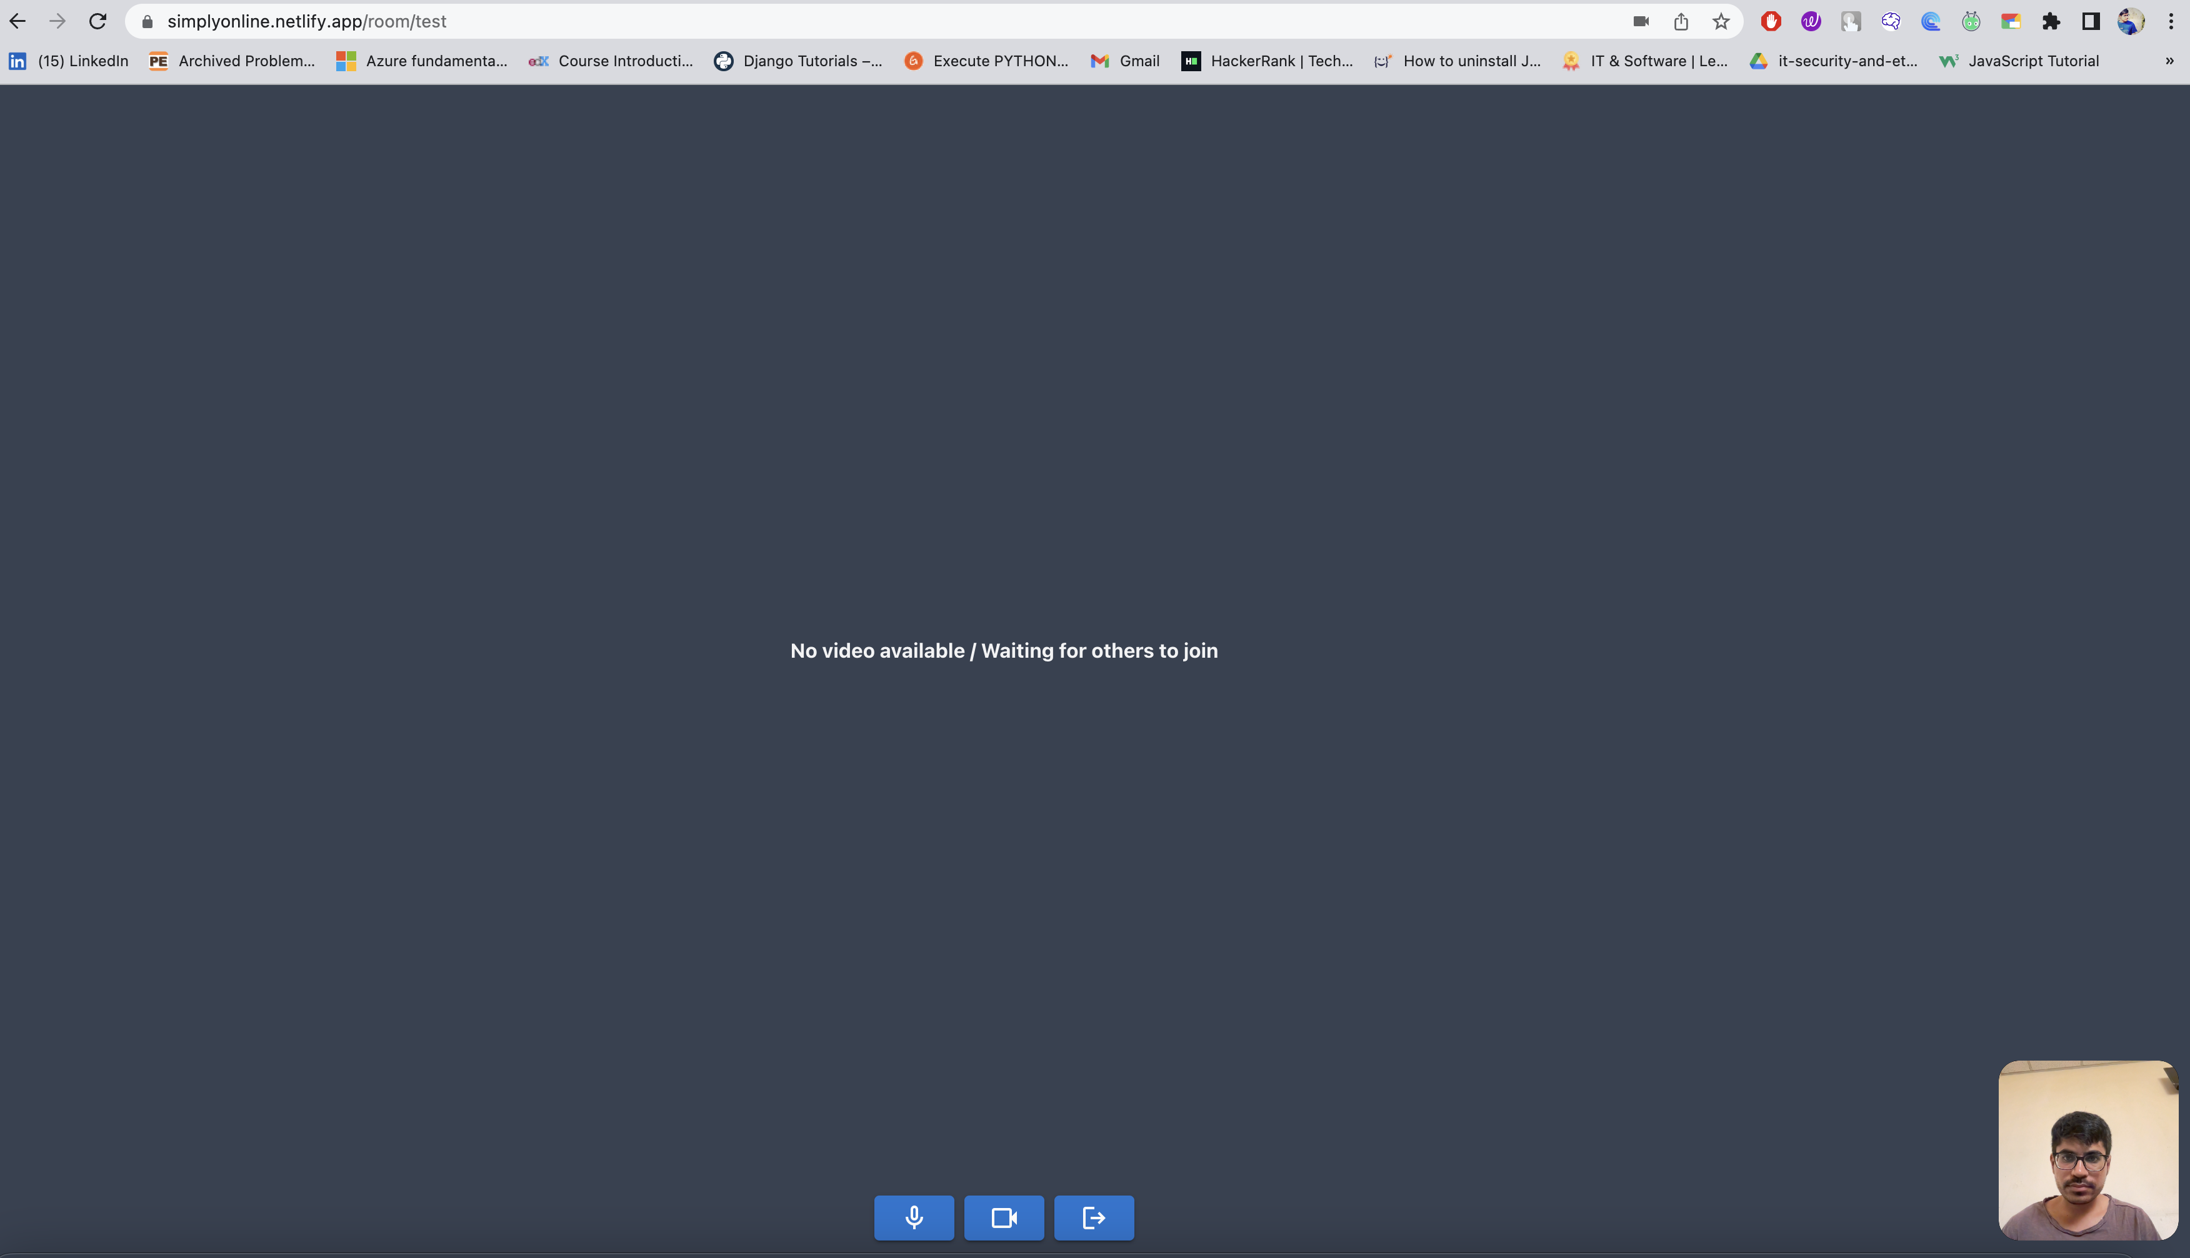
Room
Single-user room interface after joining in the room.

Slide 27
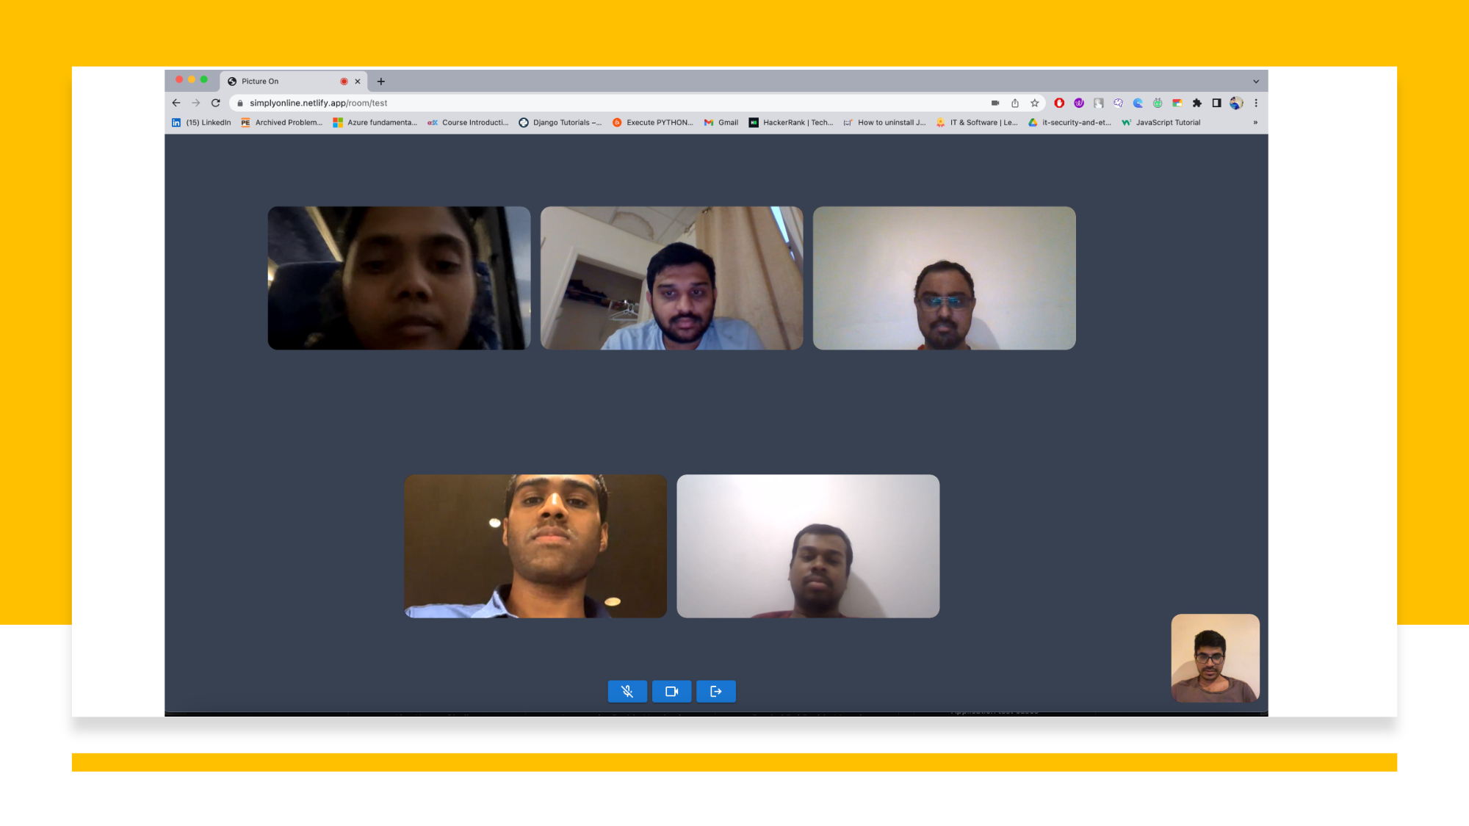
Group Call

Slide 28
Sprint-4
STORY ID | USER STORY | STORY POINTS
SIM-20 | Enable attendance marking feature to room owners | 20
SIM-30 | Test of whole application functionality | 13
SIM-17 | Implement UI to mark attendance | 13
SIM -28 | Technical paper and documentation | 20
SIM-29 | Deployment Procedure | 13
SIM-22 | Test whole application and implementation of auto attendance system | 20
In this sprint, we worked on the enable attendance marking feature, technical paper and deployment procedure

Slide 29
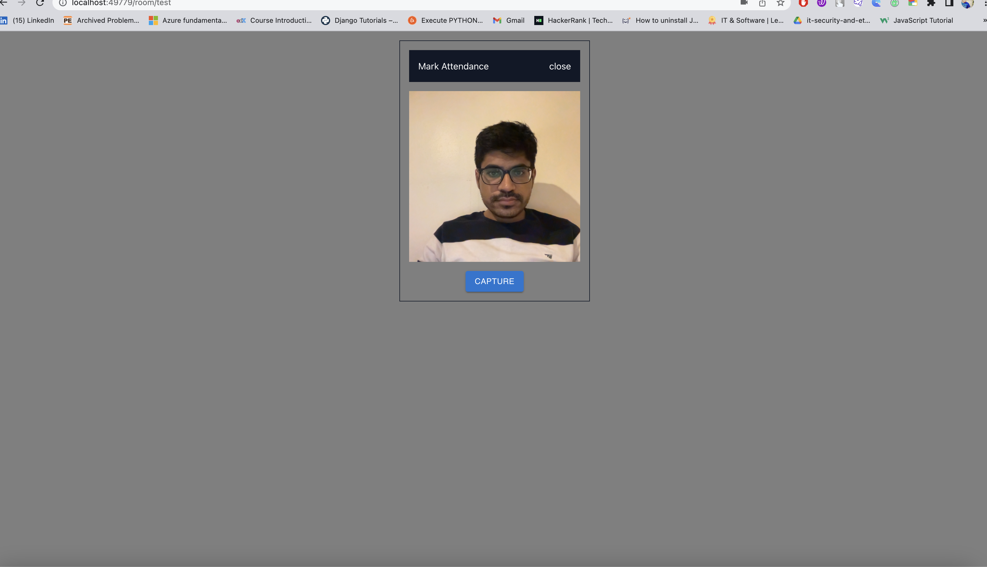
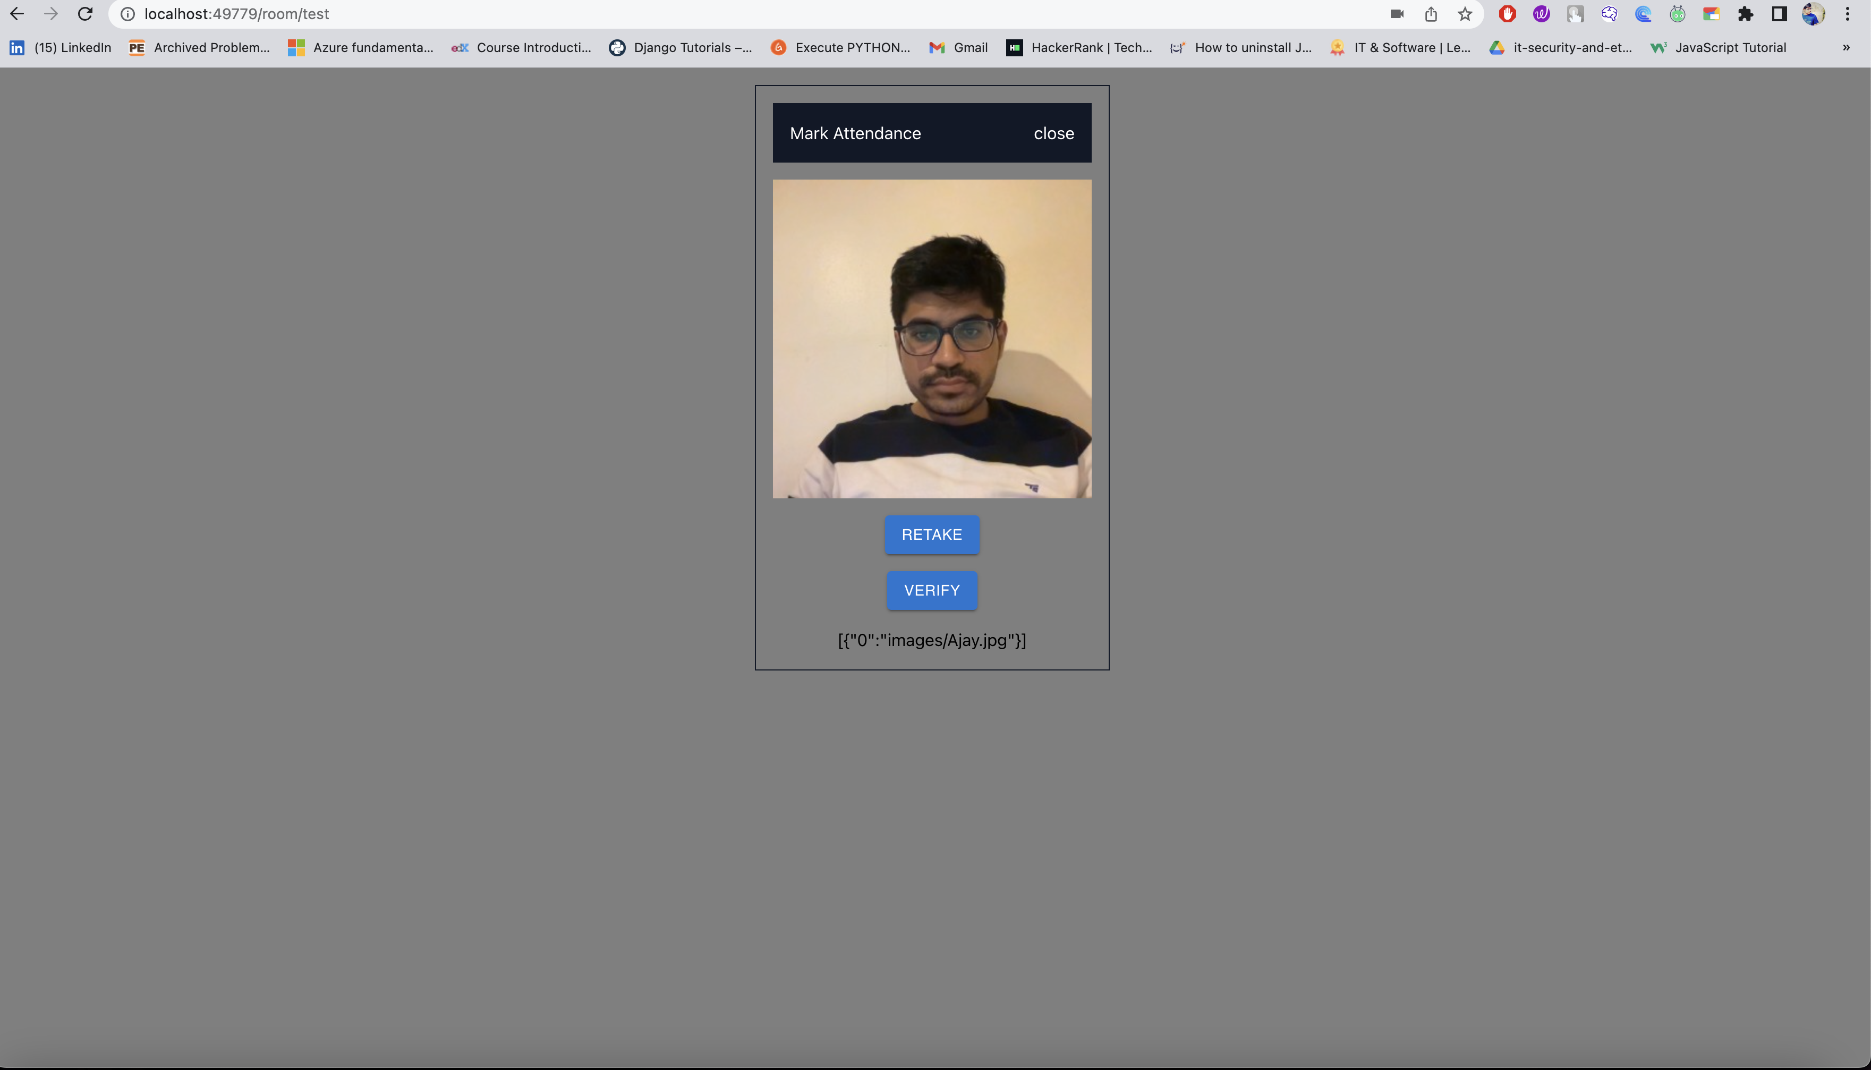
Mark Attendance/verify
This screen allows the user to capture the photo and verify that it is the same user or not

Slide 30
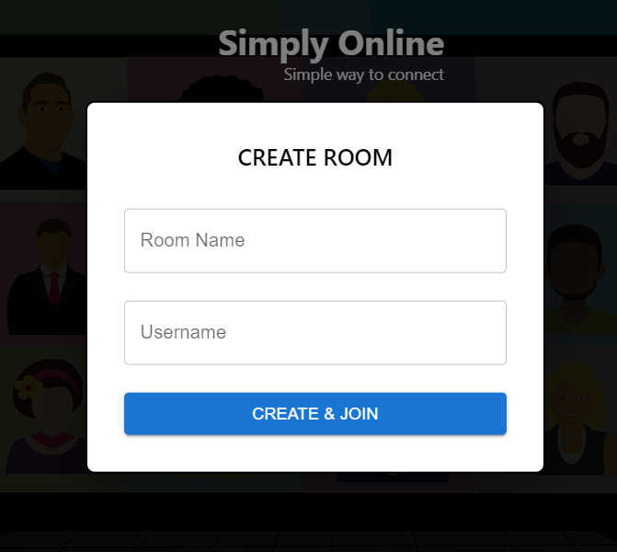
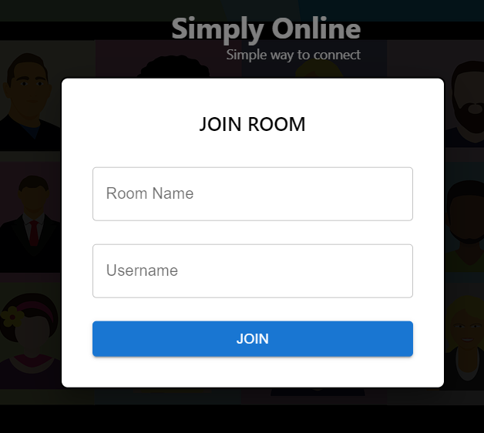
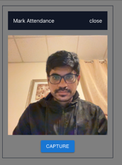
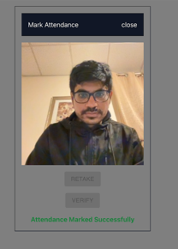
Minimal Viable Product(MVP)
Sprint-3 Recap

Slide 31
Sprint-5
STORY ID​ | USER STORY​ | STORY POINTS​
SIM-42 | Create login and signup pages | 8
SIM-43 | create tables and stored procedures for authentication | 8
SIM-45 | implement backend authentication using JWT token | 13
SIM -44 | create API's for user signup and login | 13
SIM-47 | testing login and signup features | 13
SIM-46 | integration of authentication with existing application | 5
In this sprint, we created login, signup pages and API's for login and signup
We also created tables and stored procedures for authentication

Slide 32
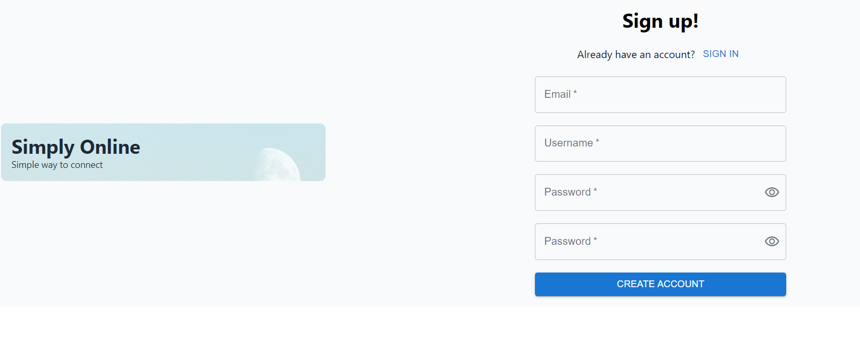
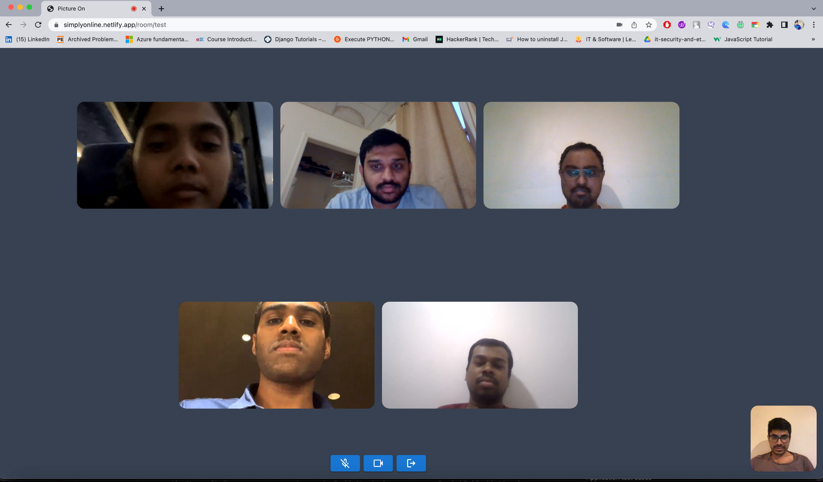
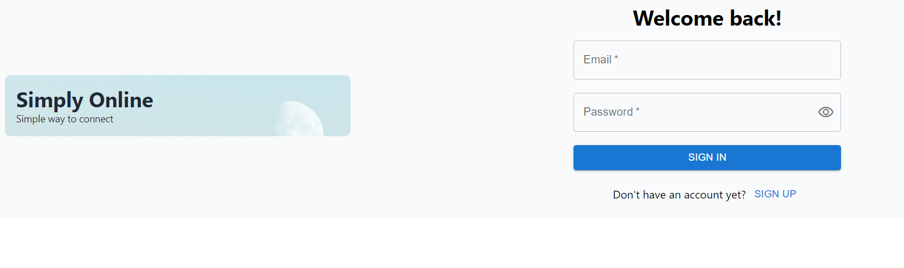
changed
Sign-up and Login pages

Slide 33
Sprint -6
STORY ID | USER STORY | STORY POINTS
SIM-21 | Enable screen sharing feature | 20
SIM-39 | Mark Attendance feature production deployment | 40
SIM-40 | Test live application with many users | 20
SIM-49 | Deploy application on public server | 40
SIM-50 | Create individual Docker images for the Front end, back end, and face recognition | 20
In this sprint, we tested the application on multiple users and deployed on public server

Slide 34
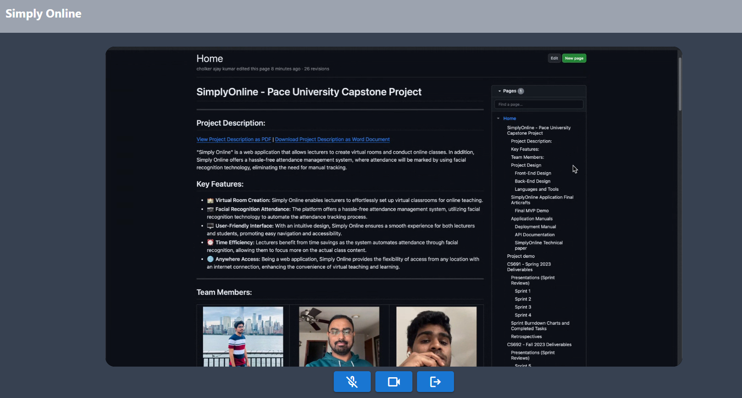
Screen Share feature

Slide 35
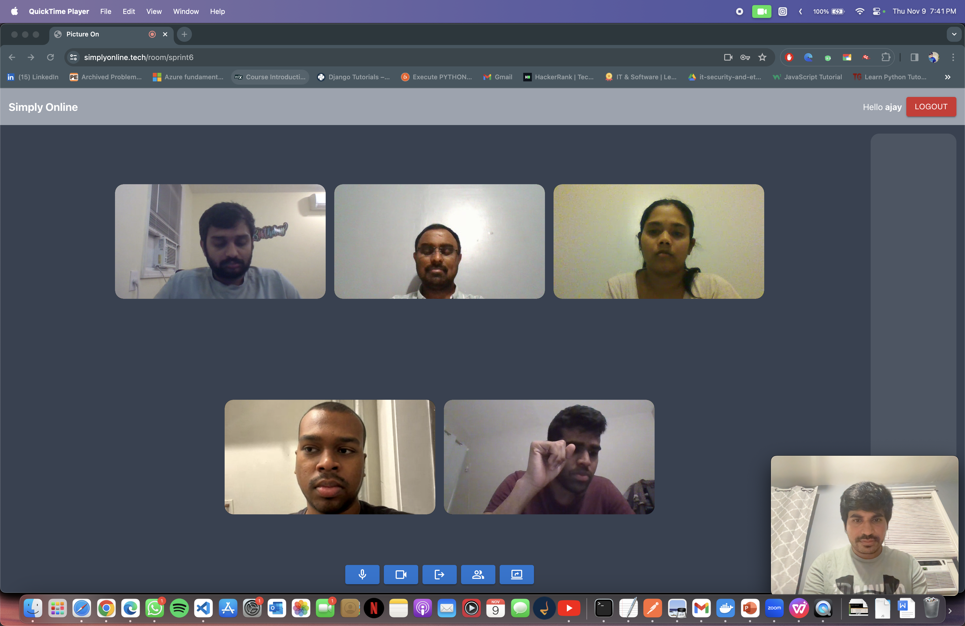
Group call

Slide 36
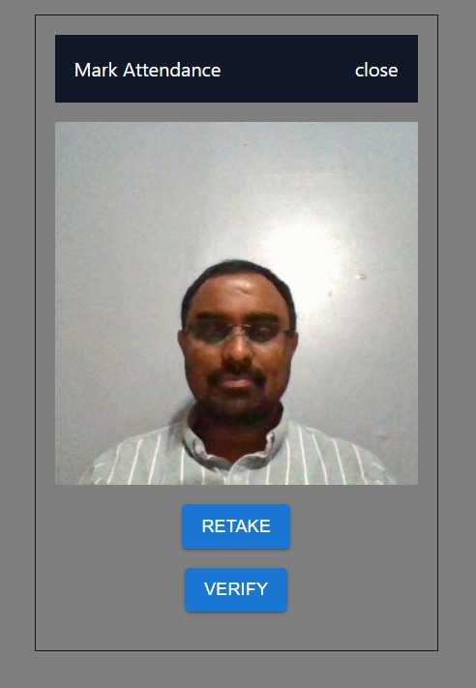
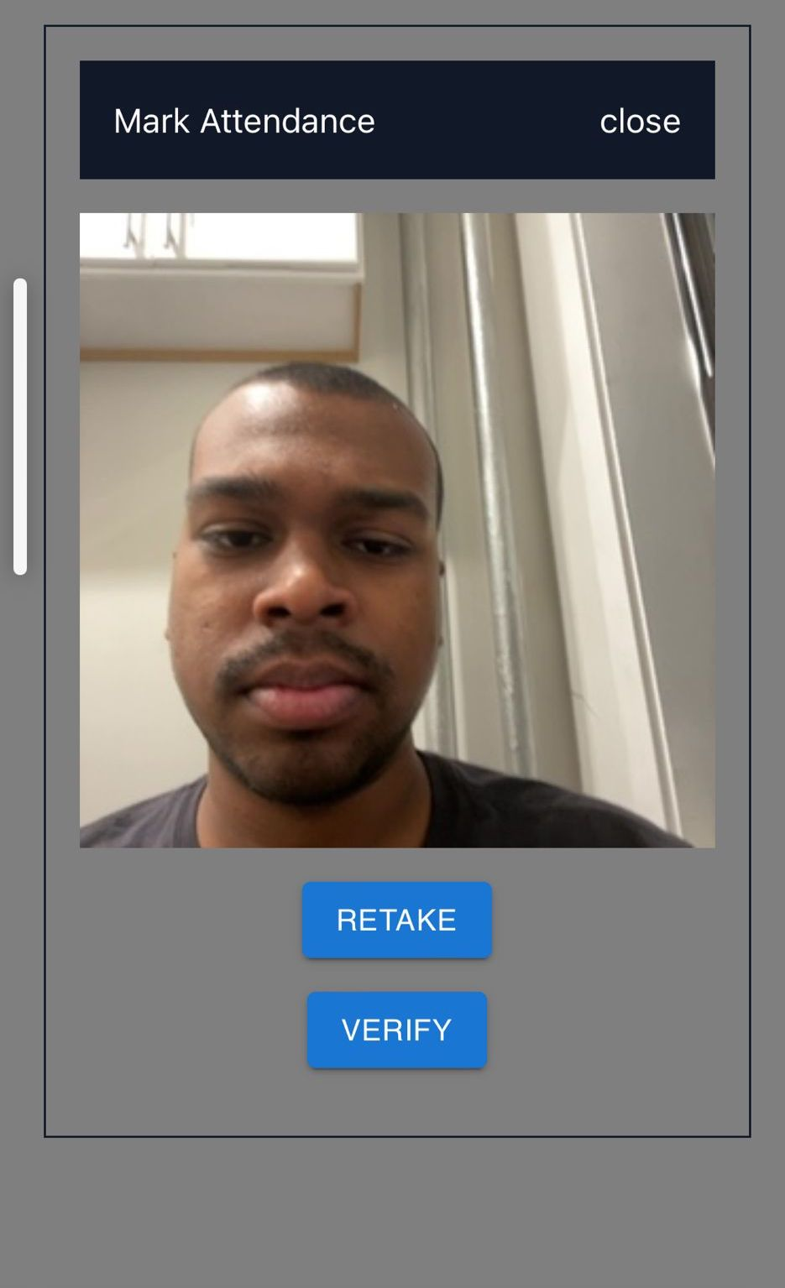
This screen allows users to capture and verify their face for mark attendance

Slide 37
Product Backlog
STORY ID | USER STORY | STORY POINTS
SIM-6 | Discussion on Framework selection | 5
SIM-7 | Create React Project | 13
SIM-8 | Research on WebRTC | 8
SIM-9 | Research on Face Recognition Implementation | 13
SIM-10 | Create Web app and connect to signalling server to generate Ice Candidates | 8
SIM-11 | Create Connection between two peers and enable video and audio calling | 20
SIM-12 | Create UX and UI for users to create and join rooms | 8
SIM-13 | Research on SFU server for group calling feature | 8
SIM-24 | Database analysis and Development | 5
SIM-26 | Connect business layer and Database layer (MYSQL DATABASE) | 5

Slide 38
Product Backlog
STORY ID | USER STORY | STORY POINTS
SIM-14 | Create UX & UI screen for group calling | 8
SIM-15 | Test the maximum users that can be connected to one group call using peer to peer | 5
SIM-16 | Create Face recognition model using tensor flow | 40
SIM-18 | Analysis and implementation of facial recognition model using tensor flow | 5
SIM-25 | Connect to Agora RTC Server to enable group video calling | 20
SIM-31 | UX changes for better interactivity | 4
SIM-32 | Implement video conference ui using agora react component library | 16
SIM-33 | Face recognition implementation using deepface | 40
SIM-34 | Research on deepface | 4
SIM-35 | Create a web api using flask to connect to face recognition code | 8
SIM-36 | Implement face recognition in UI | 14

Slide 39
Product Backlog
STORY ID | USER STORY | STORY POINTS
SIM-20 | Enable attendance marking feature to room owners | 20
SIM-30 | Test of whole application functionality | 13
SIM-17 | Implement UI to mark attendance | 13
SIM -28 | Technical paper and documentation | 20
SIM-29 | Deployment Procedure | 13
SIM-22 | Test whole application and implementation of auto attendance system | 20
SIM-42 | Create login and signup pages | 8
SIM-43 | create tables and stored procedures for authentication | 8
SIM-45 | implement backend authentication using JWT token | 13
SIM -44 | create APIs for user signup and login | 13
SIM-47 | testing login and signup features | 13
SIM-46 | integration of authentication with existing application | 5

Slide 40
Product Backlog
STORY ID | USER STORY | STORY POINTS
SIM-21 | Enable screen sharing feature | 20
SIM-39 | Mark Attendance feature production deployment | 40
SIM-40 | Test live application with many users | 20
SIM-49 | Deploy application on public server | 40
SIM-50 | Create individual Docker images for the Front end, back end, and face recognition | 20
SIM-48 | Face Registration While signup | 20​
SIM-51 | Technical Paper | 13
SIM-52 | Deployment Document | 13
SIM-53 | Testing of the whole application after Deployment | 13

Slide 41
Sprint7 – User Stories and Acceptance Criteria
Userstory | Acceptance Criteria
Face registration in signup | As a user Given user is on signup page When user clicks on Register Face button Then Popup should open and ask for face registration.
 | As a user Given user is on face registration page, When user clicks on capture button, Then photo should be captured
 | As a user Given user captured a photo Then user should see retake and save buttons
Save Face data in database | As a user Given user registered with face data Then Data should be stored in database in blob format And User should see "Registered Successfully" message

Slide 42
Sprint7 – User Stories and Acceptance Criteria
User Story | Acceptance Criteria
Train face recognition model from data stored in database. Verify faces using registered faces | As a user Given user is verifying his attendance When user clicks on capture and submits for verification Then user should be verified And attendance should be marked successfully

Slide 43
Sprint 7 Backlog
STORY ID​ | USER STORY​ | STORY POINTS​
SIM-48 | Face Registration While signup | 20​
SIM-51 | Technical Paper | 13
SIM-52 | Deployment Document | 13
SIM-53 | Testing of the whole application after Deployment | 13

Slide 44
Test Cases
UNIT TO TEST | SCENARIO | EXPECTED RESULT
Register using face | Capture photo and signup | User should see "Signed up successfully" message.
Register using face | Signup without face data | User should see an error message "Face data is required"
Face verification | Face verification to mark attendance | User should be able to verify his face data while marking attendance
Face verification | Face verification with wrong user | User should not be able to verify his data as the user is not logged in with his account

Slide 45
Completed and Non-Completed Tasks
STORY ID | USER STORY | STORY POINTS | STATUS
SIM-48 | Face Registration While signup | 20 | Done
SIM-51 | Technical Paper | 13 | Done
SIM-52 | Deployment Document | 13 | Done
SIM-53 | Testing of the whole application after Deployment | 13 | Done

Slide 46

Metrics

Slide 47
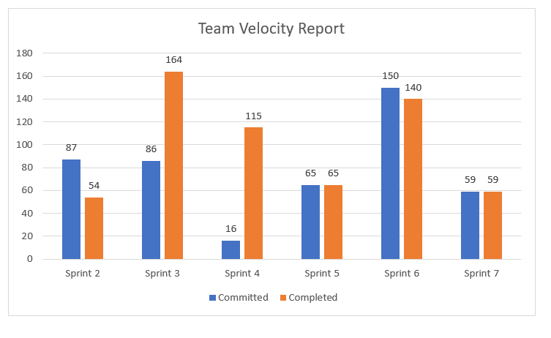

Slide 48
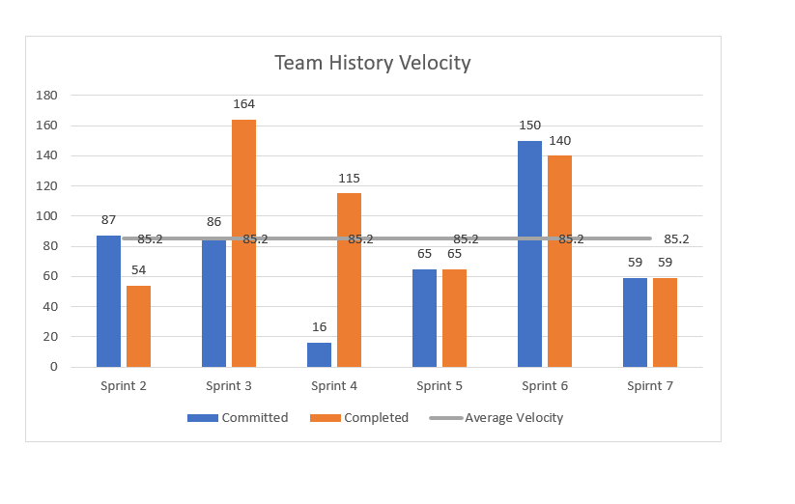

Slide 49
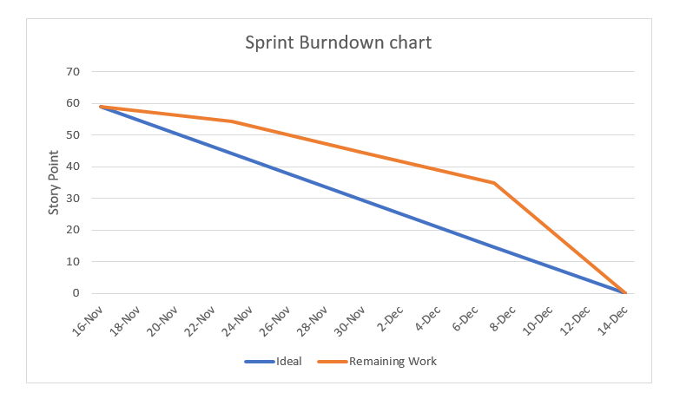

Slide 50
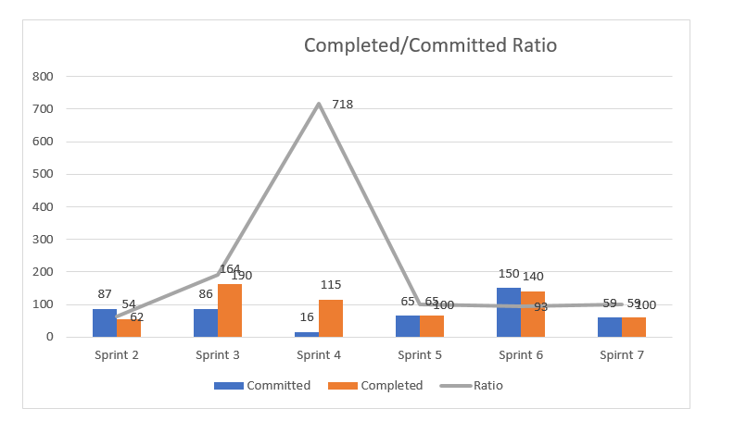

Slide 51
Retrospective
What went well:
The team successfully delivered the milestones and the final project on time.
Clear and transparent communication within the team facilitated a smooth flow of information, ensuring everyone was on the same page.
Regular retrospectives and a culture of learning allowed the team to identify areas for improvement.
Strong planning and execution strategies enabled the team to break down complex tasks and execute tasks effectively, contributing to project success.

Slide 52
What needs to improve:
Some team members lacked domain knowledge, which encountered challenges during sprints.
Improve time management by establishing better time estimation practices and prioritizing tasks to prevent last-minute rushes.
Next steps:
Arrange training sessions or workshops to enhance specific skills or knowledge gaps identified.
Establish a continuous feedback loop within the team to regularly evaluate the effectiveness of implemented changes and adjust strategies accordingly.

Slide 53
Sprint 7
STORY ID​ | USER STORY​ | STORY POINTS​
SIM-48 | Face Registration While signup | 20​
SIM-51 | Technical Paper | 13
SIM-52 | Deployment Document | 13
SIM-53 | Testing of the whole application after Deployment | 13
In this sprint, we created Face Registration while sign up and tested the whole application

Slide 54

Group call

Slide 55
Sign up, Login Page and Face Registration

Slide 56
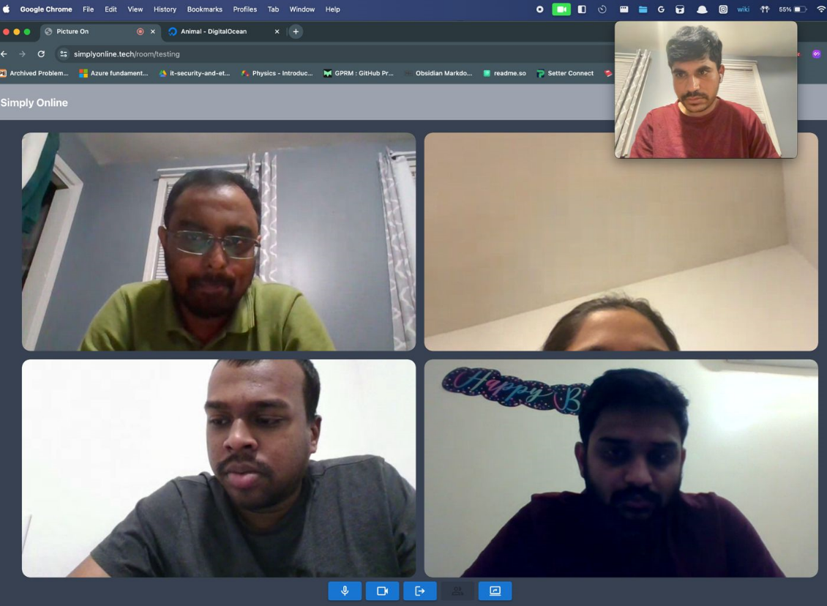
Group call

Slide 57
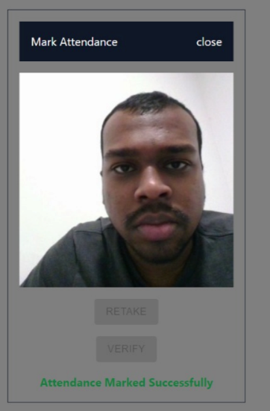
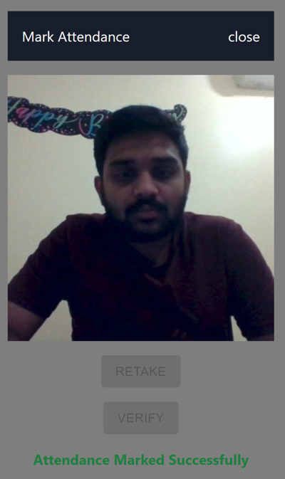
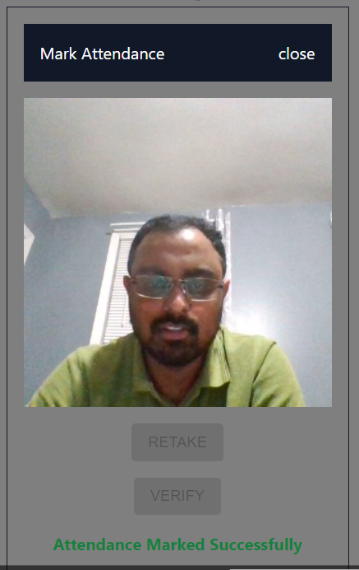
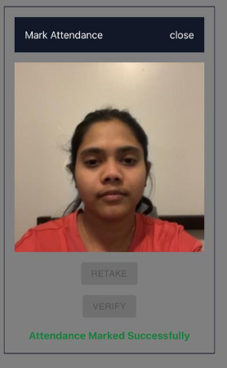
Mark Attendance/verify
This screen allows user to capture the photo and verify that it is the same user or not

Slide 58

User Attendance Board

Slide 59
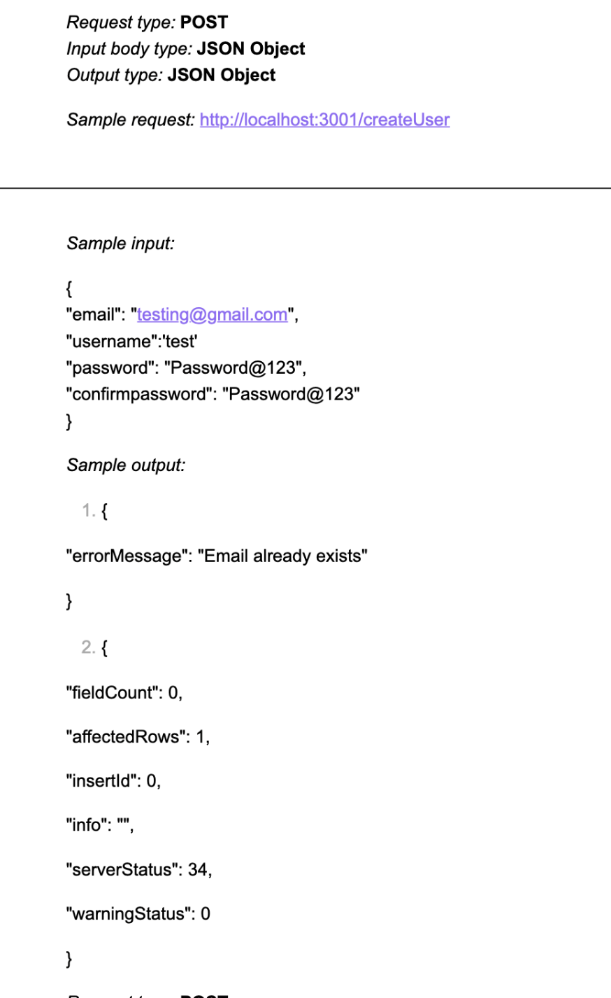
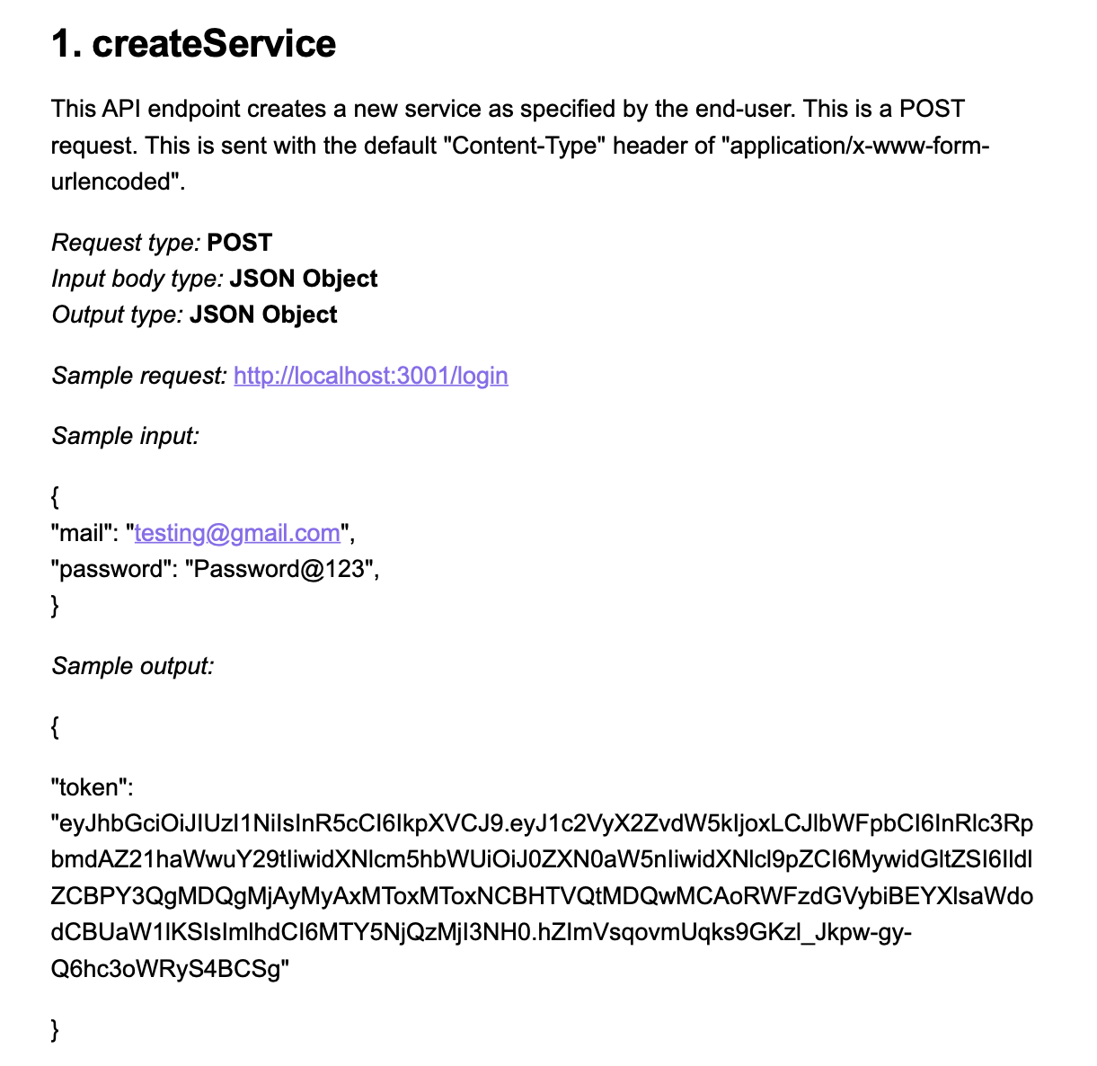
API for login and signup

Slide 60
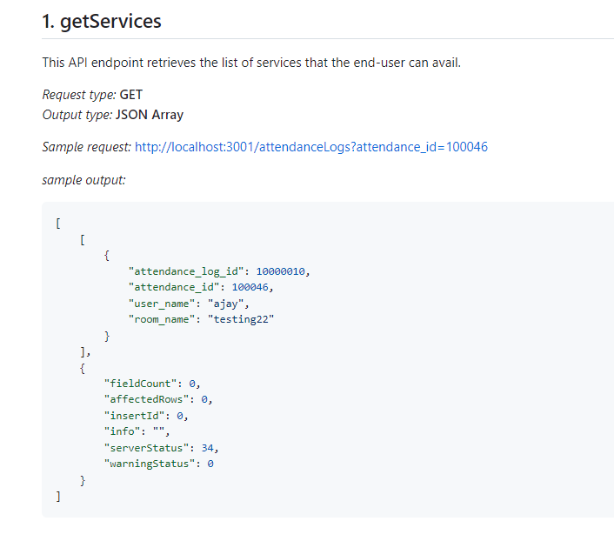
getService Api’s

Slide 61
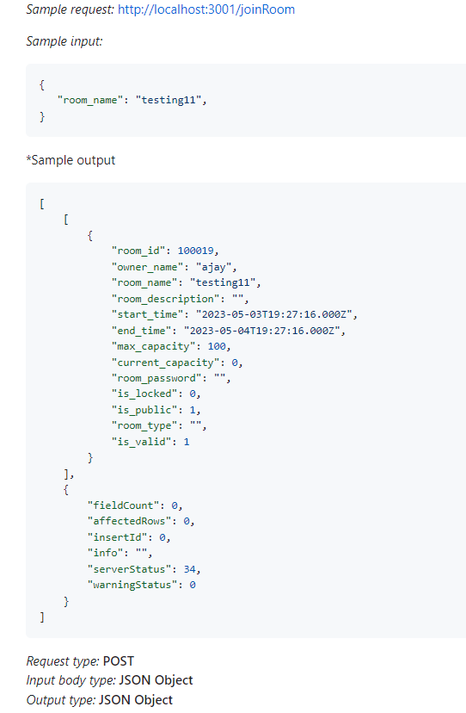
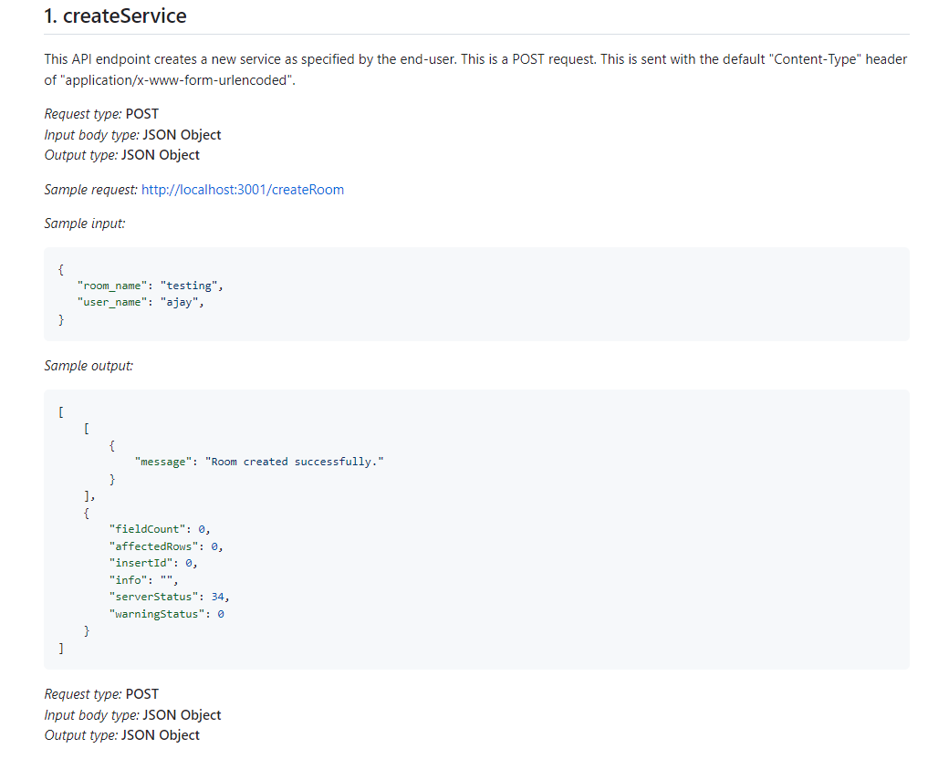
Api’s

Slide 62
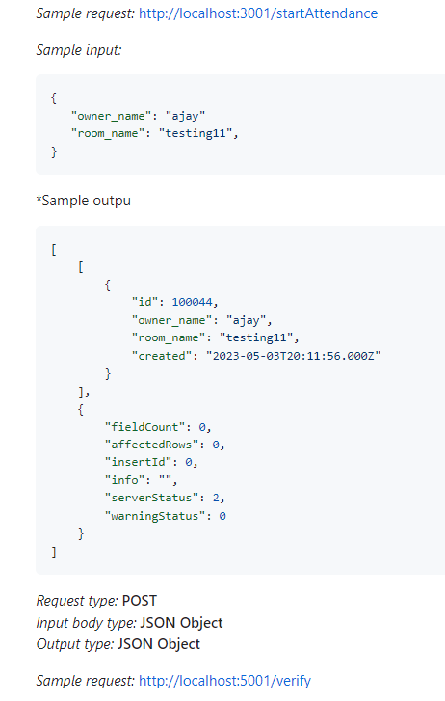
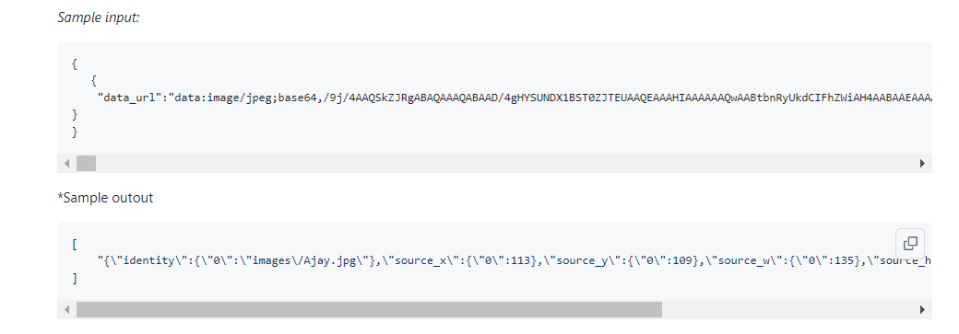
Api’s

Slide 63
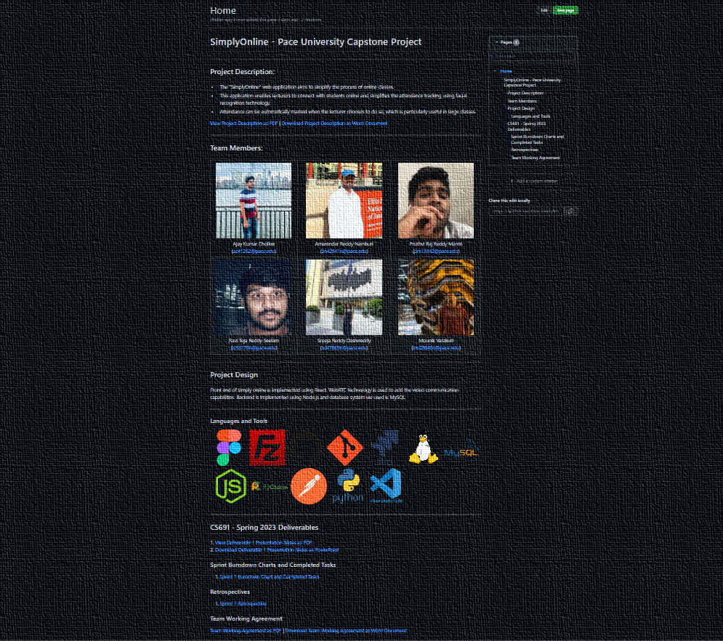
WIKI PAGE
https://github.com/htmw/SimplyOnline/wiki

Slide 64
https://youtu.be/BixxAq3mtzI

Slide 65
Thank You

